Slide 1
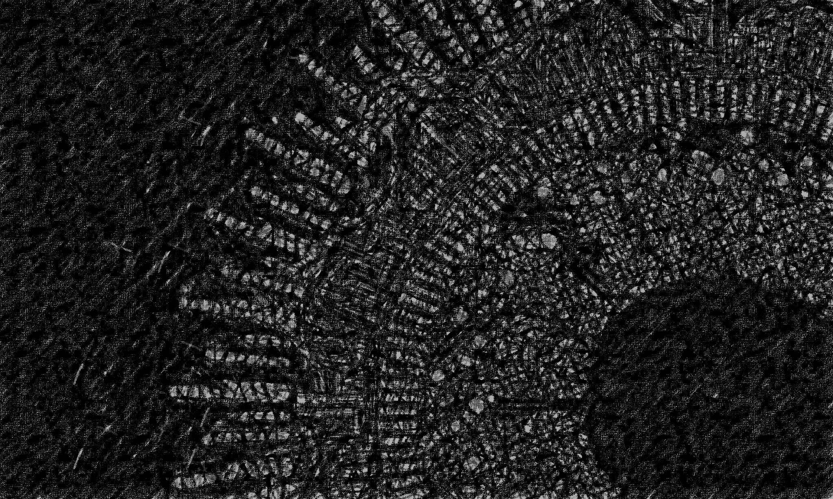


AI Workshop 3: Neural Networks Tuesday 11th February 2025
Omar Choudhry

Slide 2

Learning Objectives
By the end of this lesson, you will learn:
What is a neural network?
What are weights and bias’?
What is an activation function?
What is forward propagation?
What is backward propagation?
What is gradient descent?
How can you build a simple neural network?

Slide 3
The Human Brain

Slide 4
Simulating the brain?

Slide 5
Perceptron
The most basic neural network

Slide 6
Perceptron
The most basic neural network

Slide 7
Multilayer Perceptron
Combining multiple perceptrons together

Slide 8
Activation Functions

Slide 9
Forward Propagation

Slide 10
Backward Propagation

Slide 11
Backward Propagation

Slide 12
Gradient Descent

Slide 13
Building a Neural Network

Slide 14



Feedback
Contact
Slides are available at github.com/omariosc/ai-workshops
O.Choudhry@leeds.ac.uk
Feedback Form
WhatsApp Community Chat

